Slide 1
A Project Report On “Online Library Management System” In MCA 1st YEAR Submitted by Name: Hitali Suresh Patil Roll No: 135 Github Link: https://github.com/hitalipatil490/Hitali/upload/main Name: Vasanti Vijay Ingale Roll No: 61 Github Link: https://github.com/VASANTI2001/MCA_1.git Name: Teju Anil Kawathe Roll No: 68 Github Link: https://github.com/TEJUKAWATHE/KBCNMU.git Guided by Mrs. Utkarsha Rane Institute Of Management And Research Jalgaon(2022-23)

Slide 2
Chapter 1
Introduction to project
purpose:
The purpose of this application are as follows :
The software is for automation of library.
It provides following facilities to
Operator :
Can enter details related to a particular book.
Can provide membership to members.
1.3 Admin :
Can read and write information about any member.
Can update, create, delete the record of
membership as per requirement and implementation plants.
1.4 Scope :
The different areas where we can use this application are :
Any education institute can make use of it for providing information author, content of the available books.
It can be used in offices and modifications can be easily done To requirements.
1.5 Technology Used :

Slide 3
Front End : Servlets, HTML, Java script.
Back End : MS Access, Apache Tomcat server.
Assumptions:
This application is used to convert the manual application to the online application.
Customized data will be used in this application.
User does not have right to enter information about books.
Overview :
Project is related to library management which provides reading services to its members. Any person can be come a member of the library by filling a prescribed form. They can get the book issued, so that they cab take home and return them.
Functionality :
Online membership.
Keeps the track of issues and submission of books .

Slide 4
Chapter 2
System Study & Analysis
Software Development Life Cycle:
The definition of software development life cycle would be an activity aimed at achieving the highest quality in the shortest time possible with minimal effort. Technically speaking, SDLC is an optimization strategy
To explain why the software development life cycle is important, let us mention that it imposes a structure upon a complex development process. Looking at the entire goal might be quite overwhelming. Thus, splitting it into smaller feasible goals makes the whole task more approachable and flexible, provides an opportunity to alter the final outcome as you go.

Slide 5
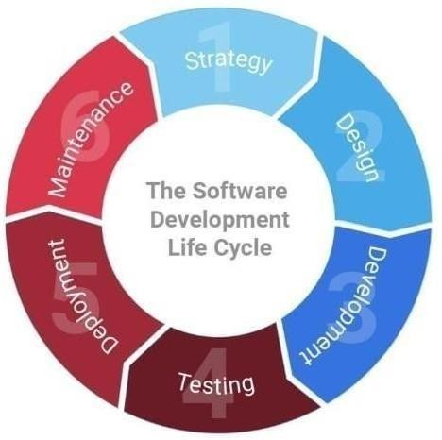
Waterfall Model:
Over history, humanity was trying to come up with a perfect software development life cycle model. The Waterfall model was the first one to ever exist among its alternatives. It is a simple linear model, where the outcome of every step becomes the input of the next one. Thus, a new step cannot be taken until the previous one is completed. This approach works best for complex projects which are constant in their requirements and regulations.

Slide 6
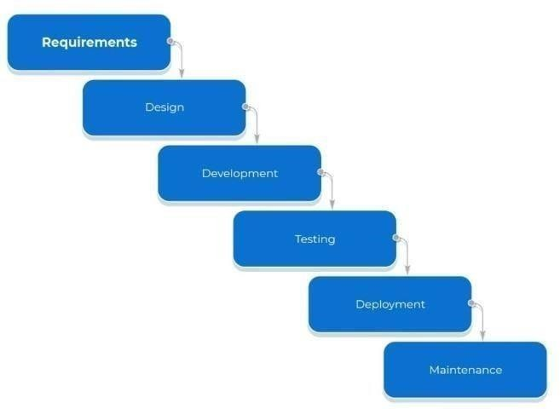
1. Analysis
First things first: before starting the development, we
need to figure out what exactly is to be created. That is when the software development life cycle analysis phase begins. To create a functional and relevant product, one has to figure out what already is out there in the market, and what is yet to come. That is to say, we are looking for the gaps that require filling.

Slide 7
Planning
Once we know what we are going to do, it is required to determine how we are going to do it: what is our final goal, what exactly is to be done to reach it, what comes first and last, etc. The software development life cycle planning phase is all about the distribution of time, resources, and efforts.
Design
The design phase in the software development life cycle is the beginning of creation. Once the purpose and specification of the product are determined, a developer will create a project design. The design usually includes both descriptions of low-level components, algorithms, and the architecture overview.
Development
Once the product has been designed, the actual code writing begins. This is when the development phase takes place. Now, a developer comes up with an executable program, that will be performing specific tasks and achieving the expected results.
Testing
To ensure the quality of the product, any new changes are to be carefully checked before being deployed. The software development life cycle testing phase helps reduce errors, find flaws

Slide 8
and ways to improve them by exposing the code to an environment similar to the final user experience. Basically, this is how developers bring the project to perfection.
Deployment
When the testing is over and everything has been said and done, it is time to apply all the changes that we have been working on. The product becomes available to the clients during the implementation phase in SDLC.
Maintenance
As mentioned at the beginning of this article, we bring an idea to life as we speak to the machine in its native language. Thus, a final product might resemble some kind of a peculiar living being that breathes and changes. The maintenance phase of the SDLC is aimed at checking its vitals, keeping it functioning, and analyzing its behavior.

Slide 9

Chapter 3
Feasibility Study
In feasibility study phase we had undergone through various steps which are describe as under:
Identify the origin of the information at different level.
Identify the expectation of user from computerized system.
Analyze the draw back of existing system (manual)system.
WORKING OF PRESENT MANUAL SYSTEMEM
The staffs of library are involved in the following tasks.
1.Membership process: person have to fill membership form and they are provided with member id.
DRAWBACKS OF PRESENT SY
:
Fast report generation is not possible.
Tracing a book is difficult.
Information about issue/return of the books are not properly Maintained.
No central database can be created as information is not available
in database.
PROPOSED SYSTEM
There will be three major components:
Stock maintenance.
Transaction entry.
Reports.
Proposed system provides with following solutions:
It provides "better and efficient" service to members.
Reduce the workload of employee.
Faster retrieval of information about the desired book.
Provide facility for proper monitoring reduce paper workand provide data security.

Slide 10

Chapter 4
System Design & Requirement & Specification
An attractive and methodical online pet shop System requires the amalgamation and utilization of modern technologies like the PHP, CSS and MySQL.
PHP - It is a server-side scripting language designed for web development but also used as a general- purpose programming language. PHP is an acronym for "PHP: Hypertext Pre-processor".
CSS - This is used for styling purpose. HTML coding is just a structure and CSS is applied to dictate the look and feel. Font size, font color, font style styling of images, page layout, and more are determined by CSS.
MySQL - It provides us a way to integrate and manage the database for the policy system by using the various commands to handle the queries.
XAMPP – This is a software used to connect php files and the database on a local server
Chrome

Slide 11
Hardware Specification: Processor
Pentium 4 and Up-graded. RAM:
Min. 512 MB
Hard Disk: Min. 40 GBfree
Software Specification :
Platform: Windows 10
Scripting Language: PHP, JavaScript
Front End: HTML, CSS, J-query, Bootstrap Database: My SQL
Web Server: xammp Server Web Browser: Google 31.0.1650 and above

Slide 12
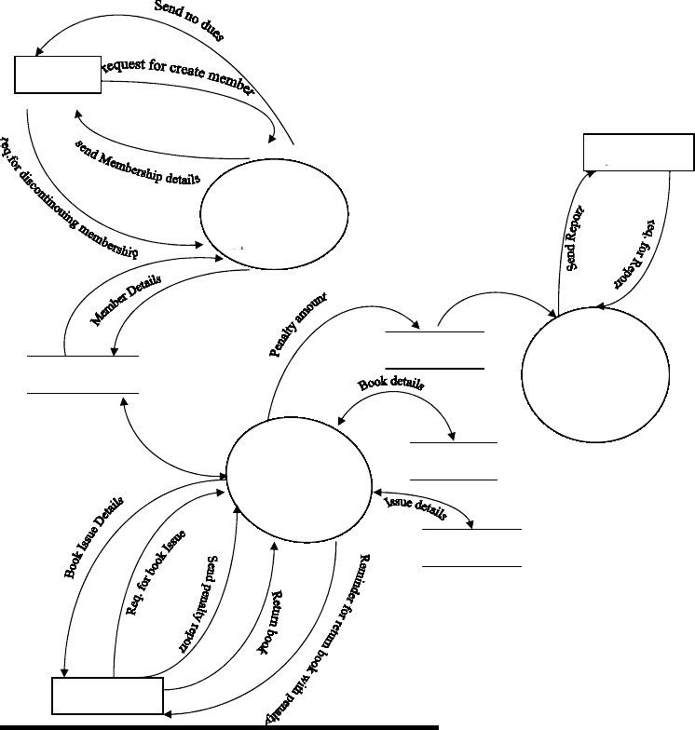
Chapter 5
Data Flow Diagram (DFD)
Data Flow Diagram is a graphical technique that detects information flow and transformations that are applied as data move from input and output. DFD is a central tool and the basis from which other components are developed. DFD provides mechanism for a final modeling as well as information flow modeling. DFD has very simple notation which are easily understood by the user & those who involved in the system.

Slide 13
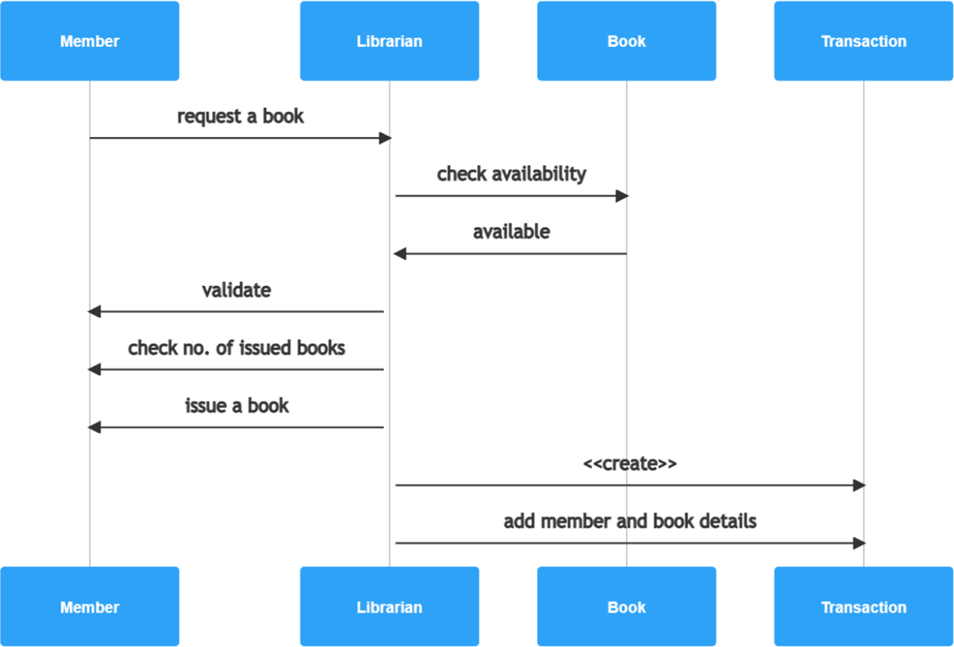
Chapter 6
Sequential - Diagram

Slide 14
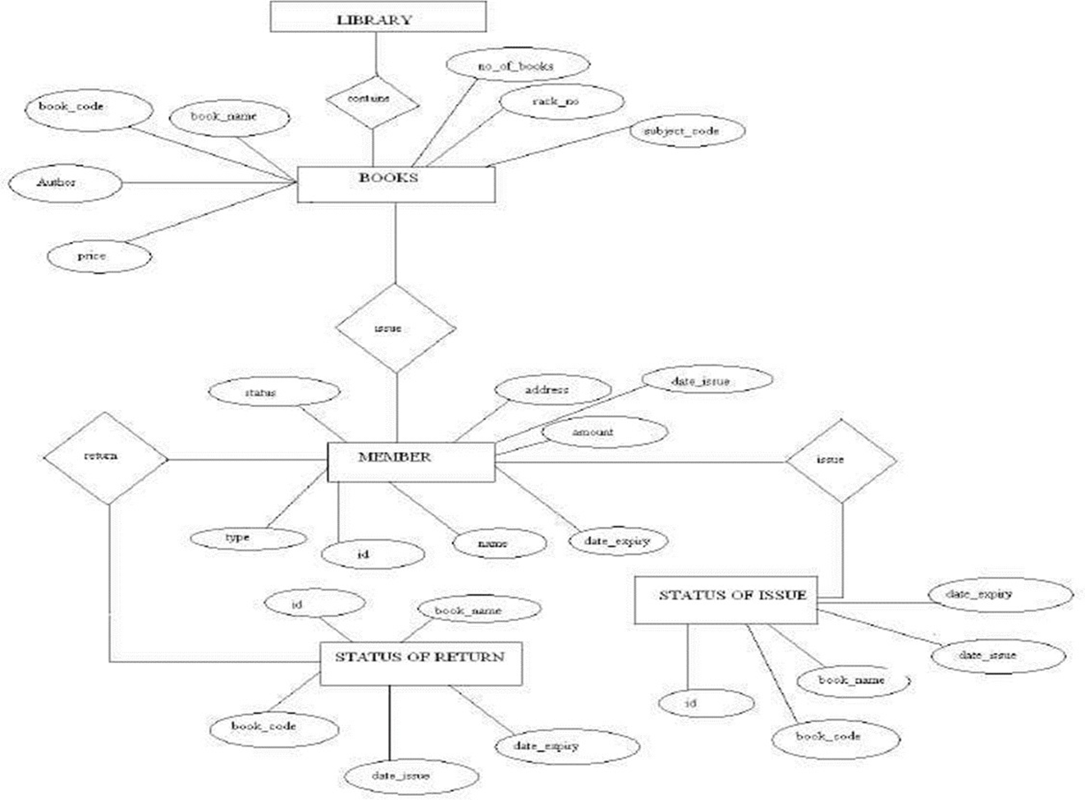
Chapter 7
E-R DIGRAM
E-R DIGRAM
It is clear that the physical objects from the previous section – the books, library – correspond to entities in the Entity-Relationship model, and the operations to be done on those entities – holds, checkouts, and so on – correspond to relationships. However, a good design will minimize redundancy and attempt to store all the required in information as small a space as possible

Slide 15
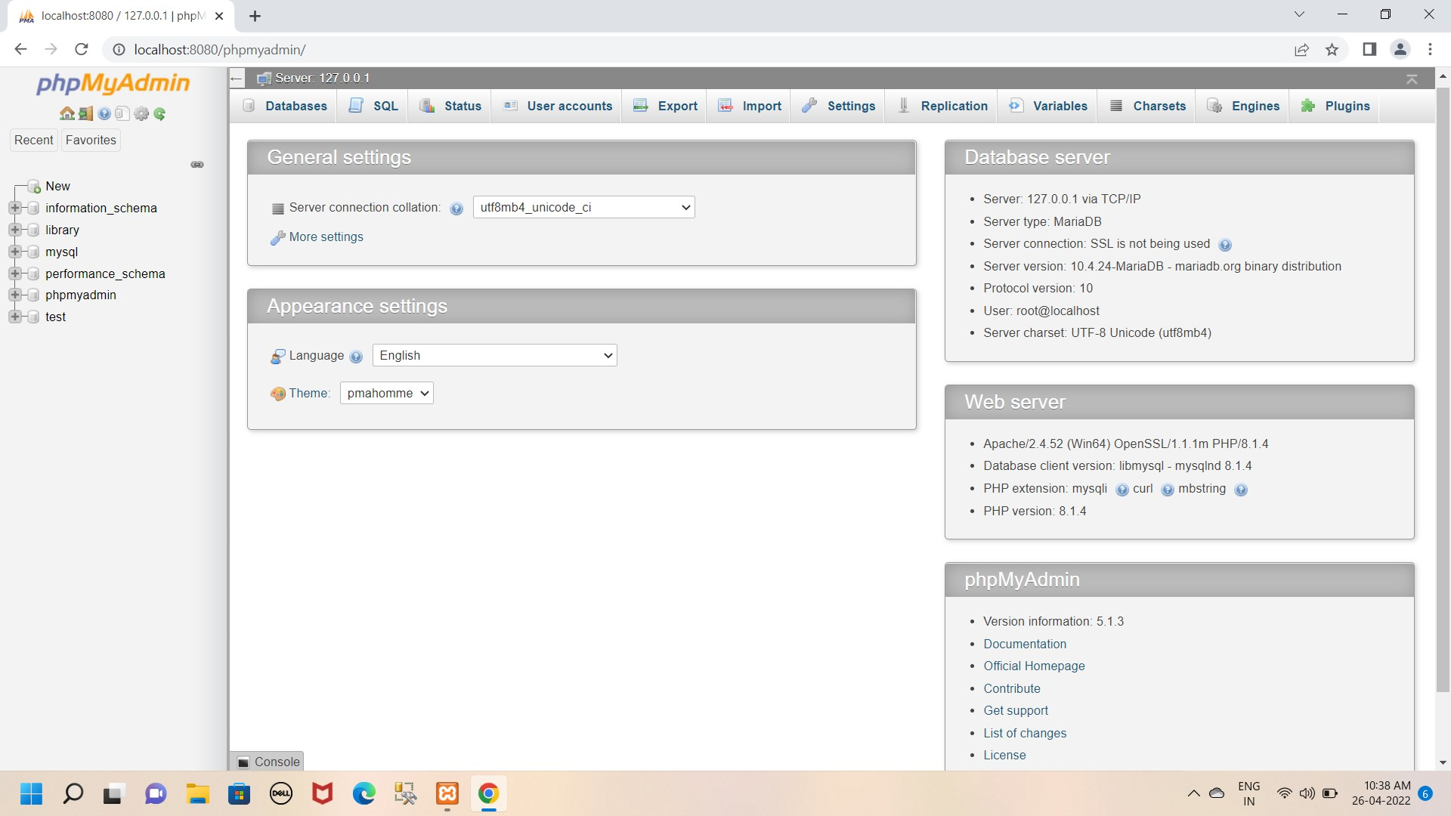
Chapter 8
Database Design
The Database Library System is intended to Automate the library activities such as creating a new borrower, giving books to the borrowers, maintaining the details of all the item that were available in the books . This also helps the librarians by providing information such as total copies available each book, list of books that belong to a particular category (Short, Long Loan, Reference items, etc).
Design view:

Slide 16
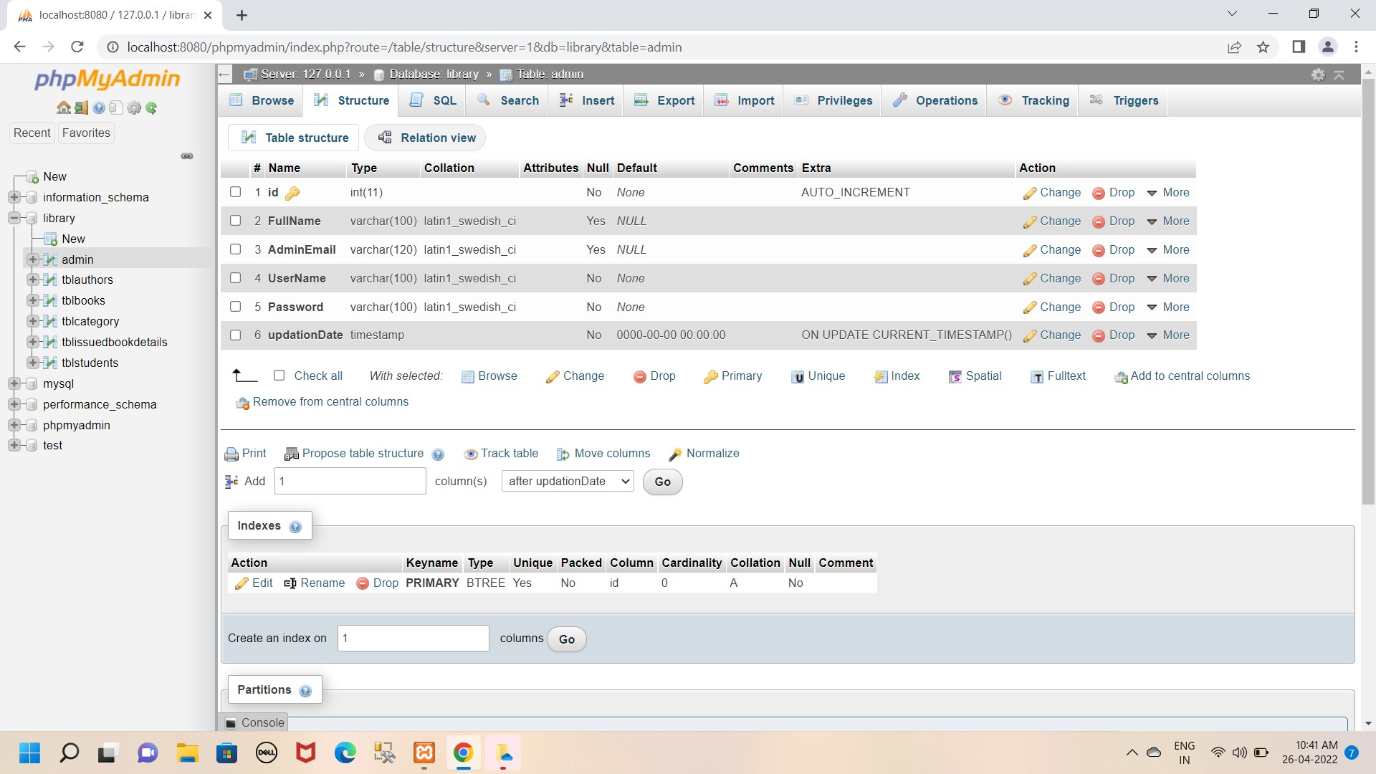
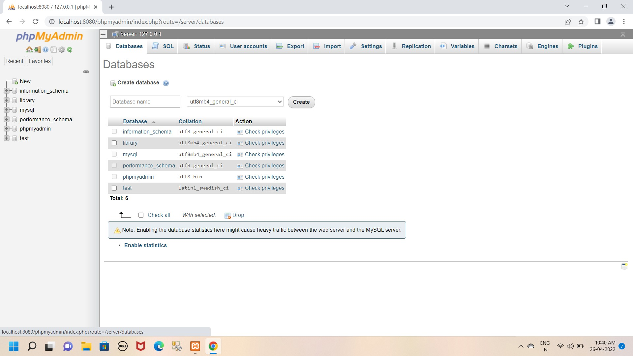
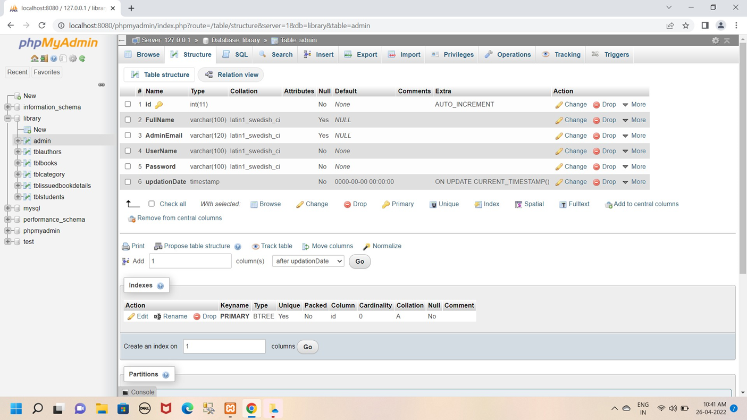
Database view:
Admin Table:

Slide 17
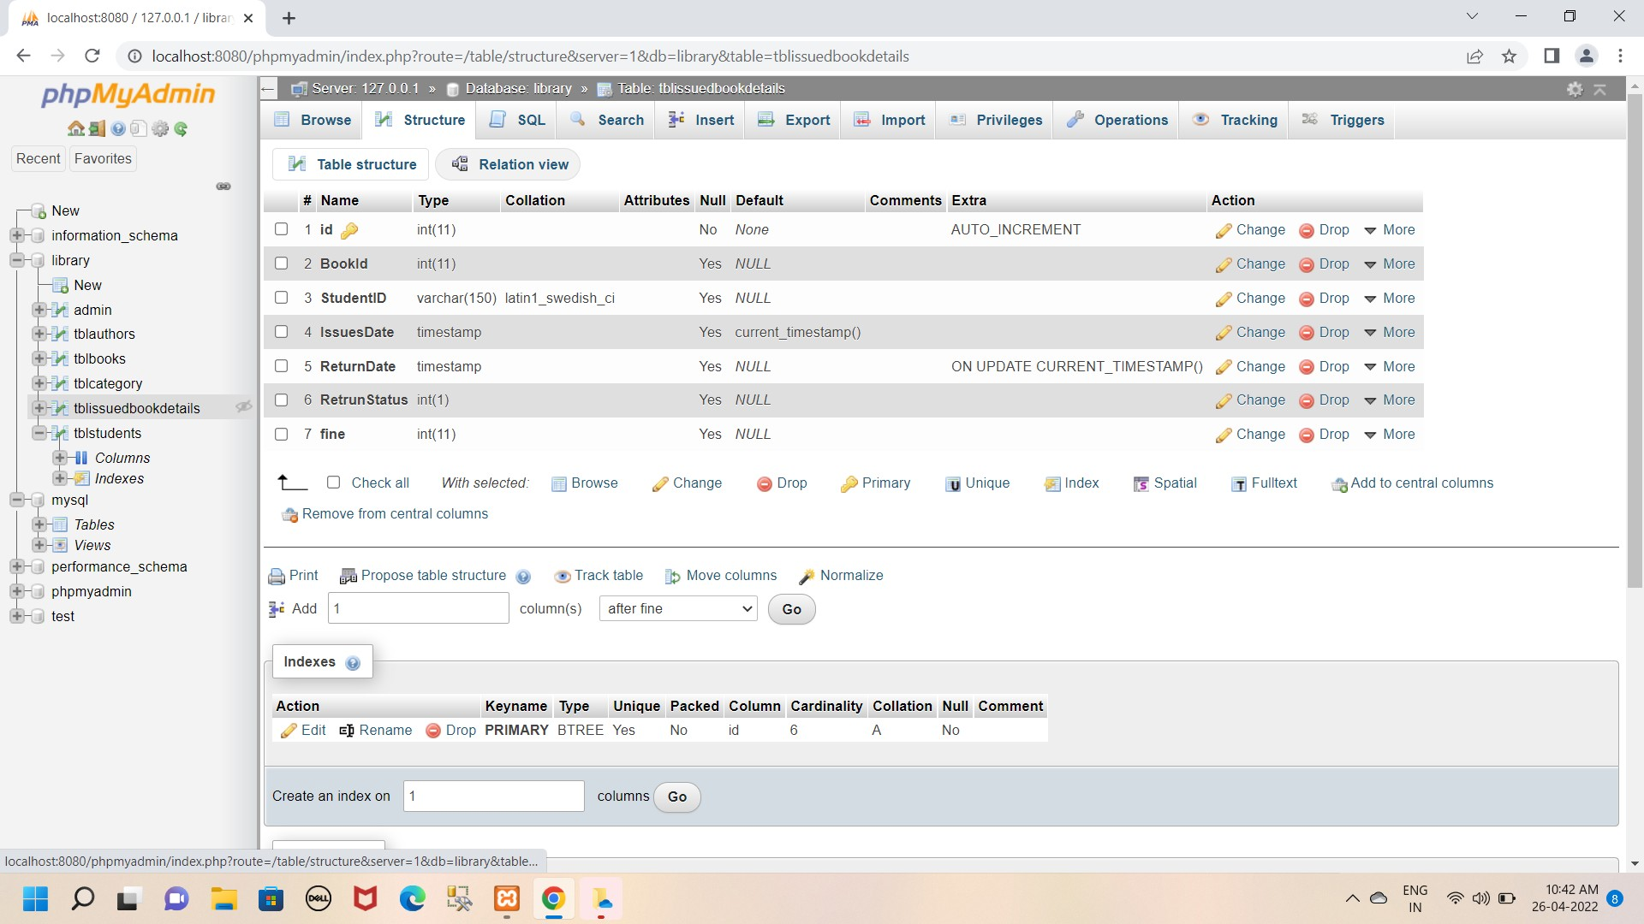
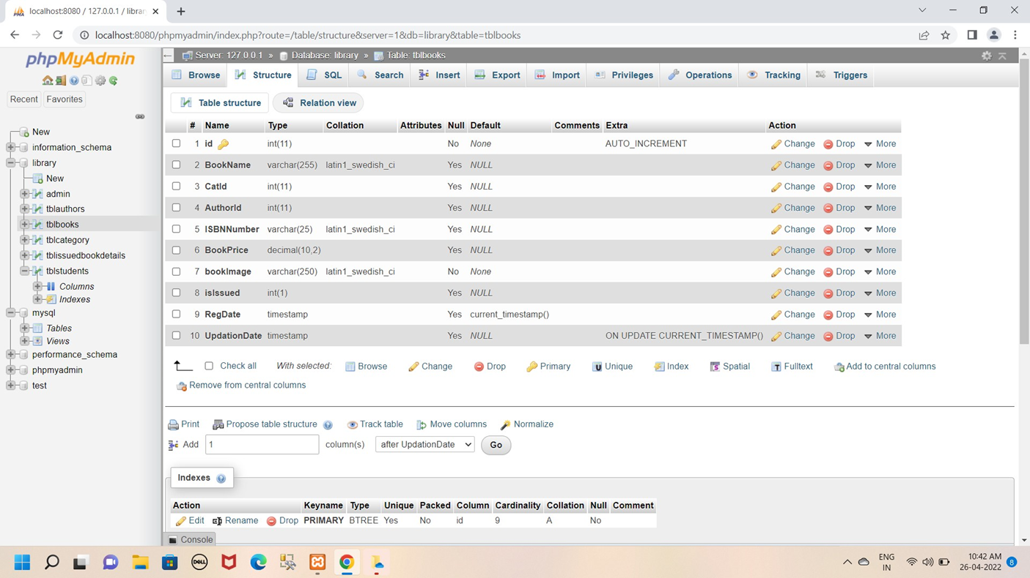
Issue Book Table:
Book Table:

Slide 18
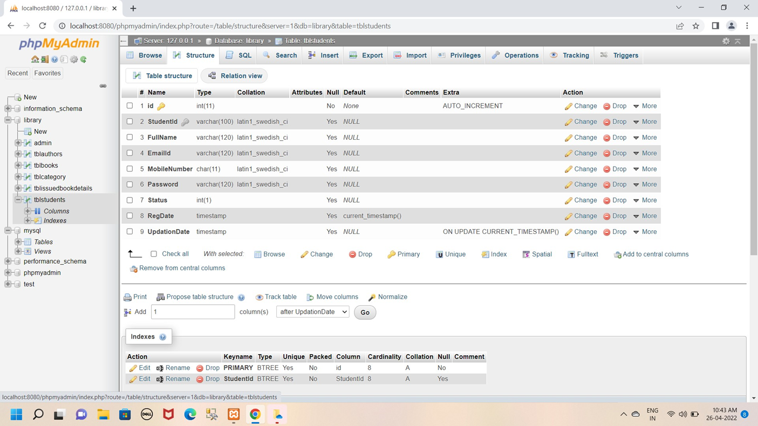
Student Table:

Slide 19
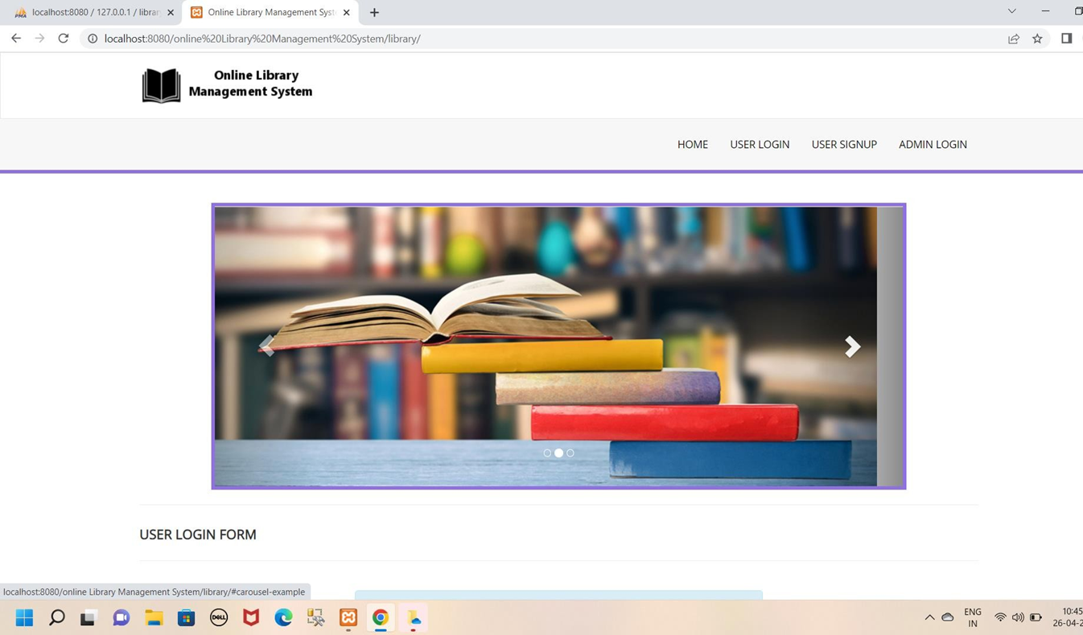
Chapter 9
Snapshot of Project
Home page:

Slide 20
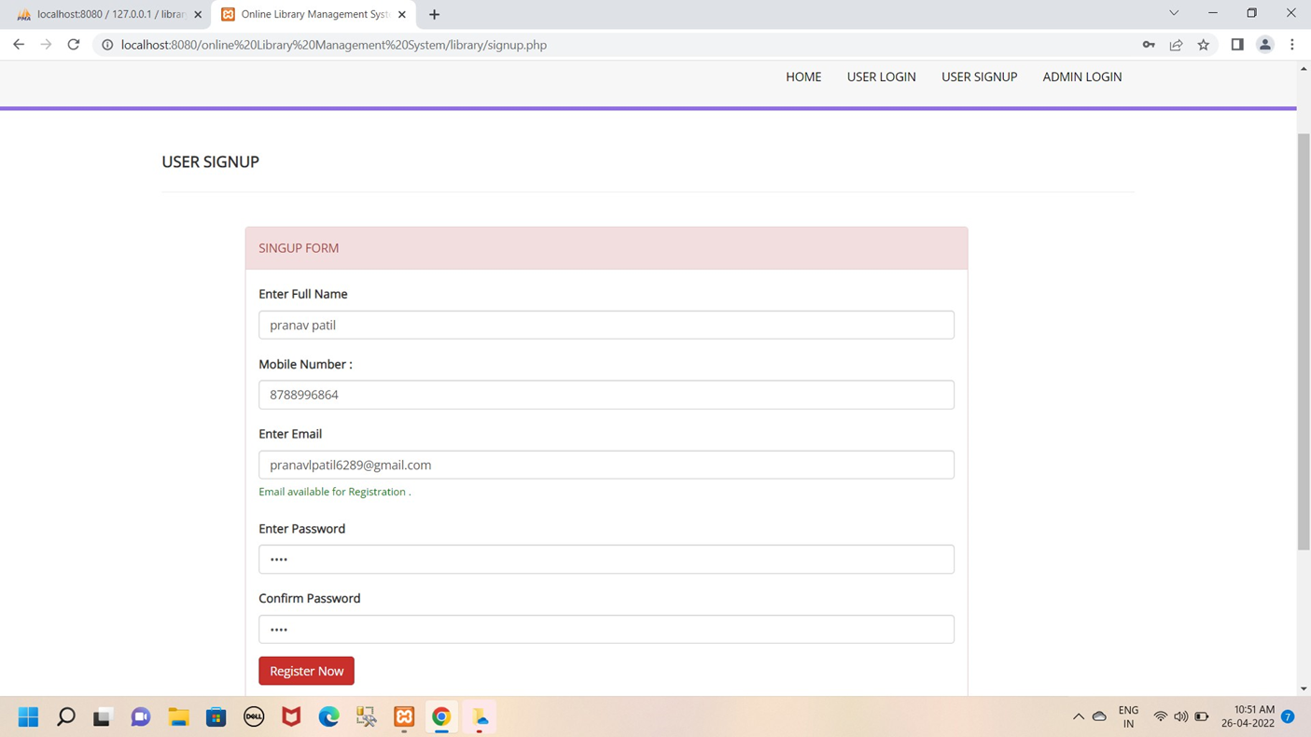
New Student Registration form:

Slide 21
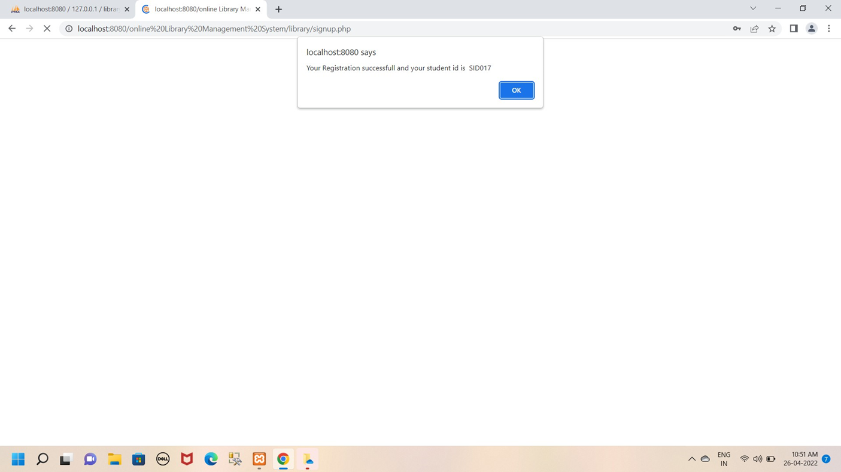
Successfully Registration:

Slide 22
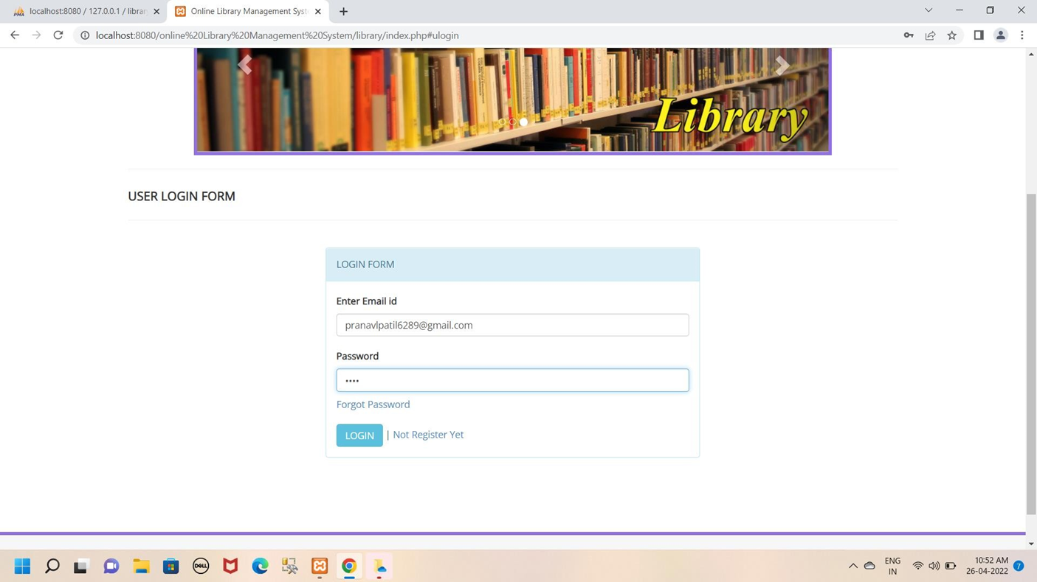
Student Login Form:

Slide 23
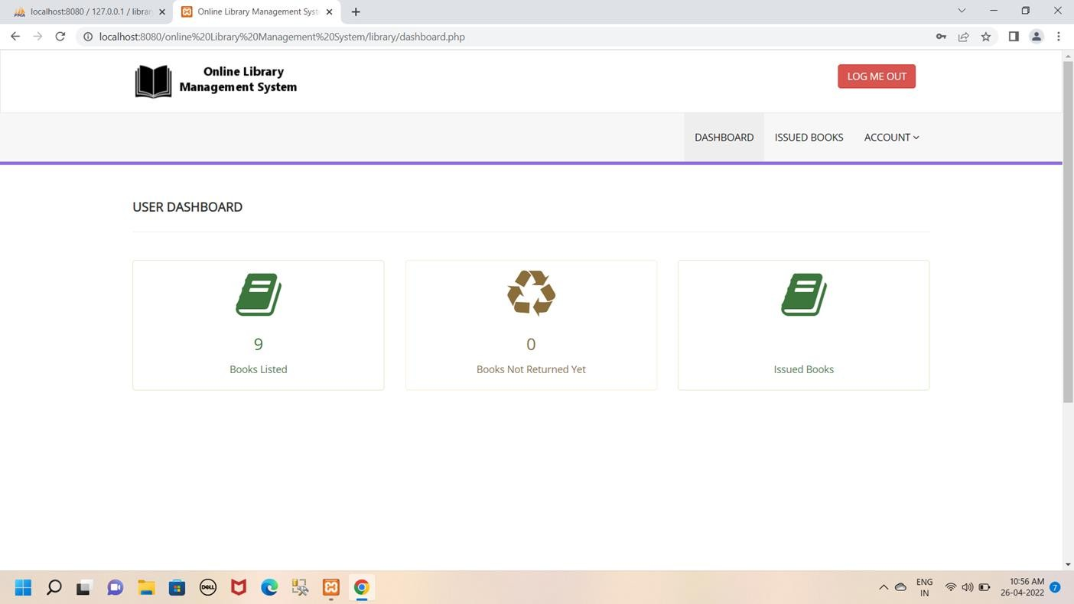
Admin Dashboard:

Slide 24
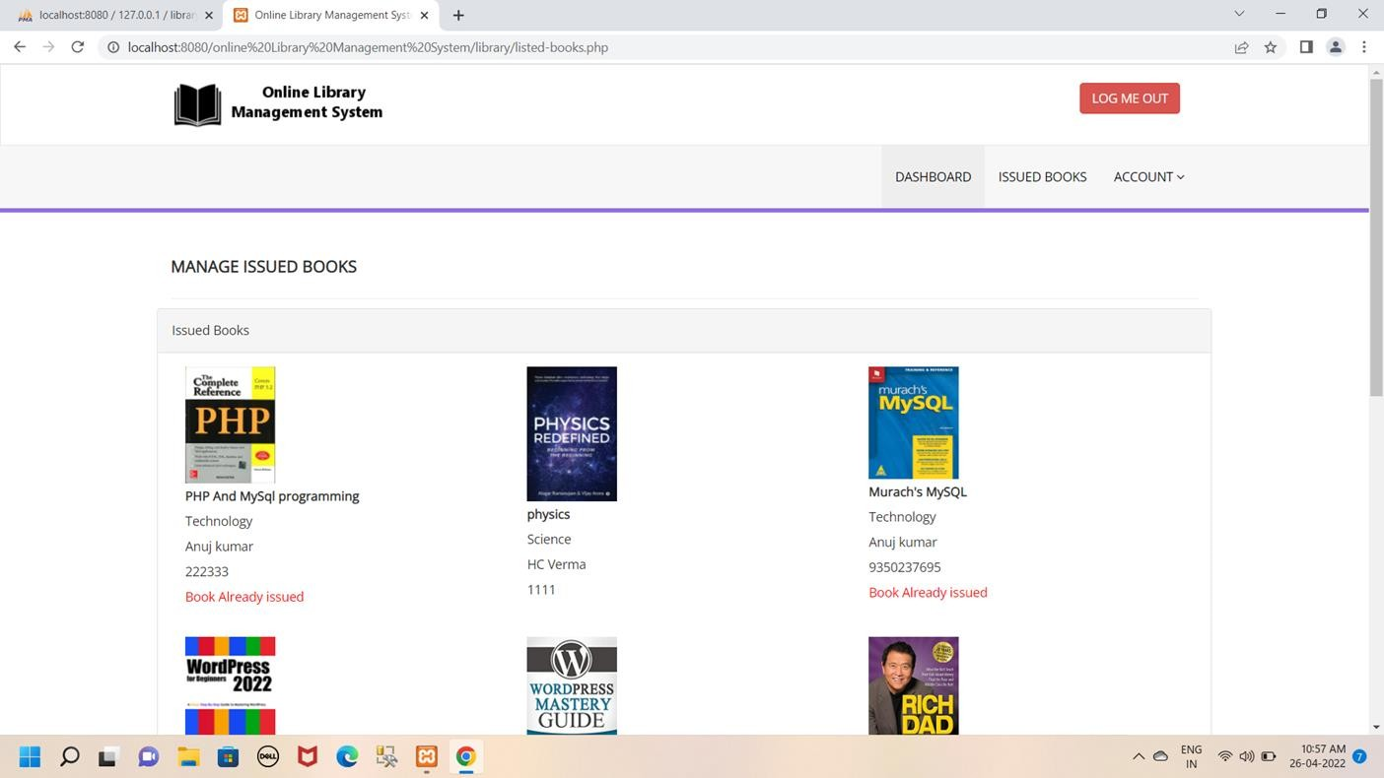
Issue Book Dashboard:

Slide 25
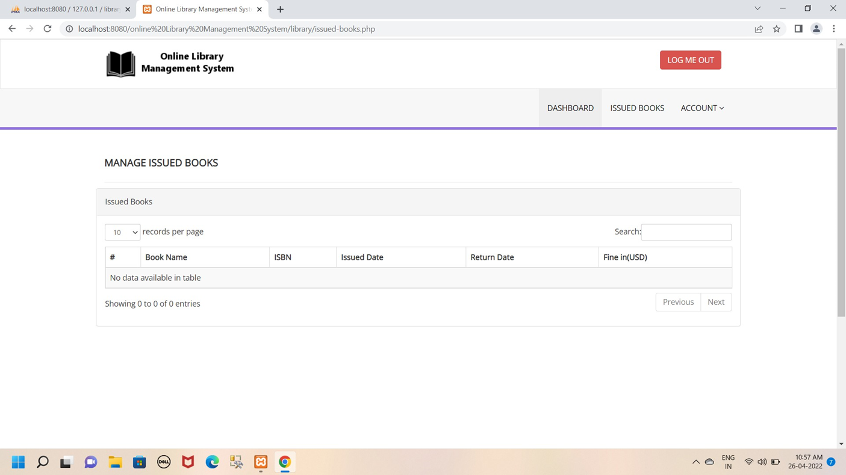
Display Issue Book:

Slide 26
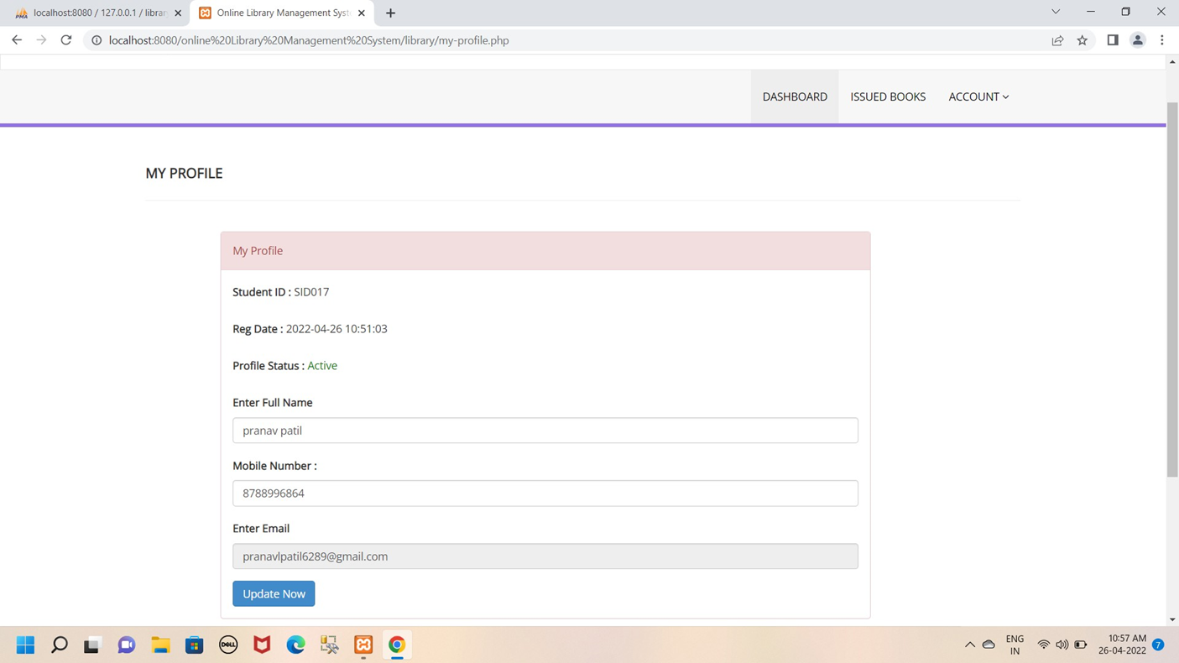
Display My Profile:

Slide 27
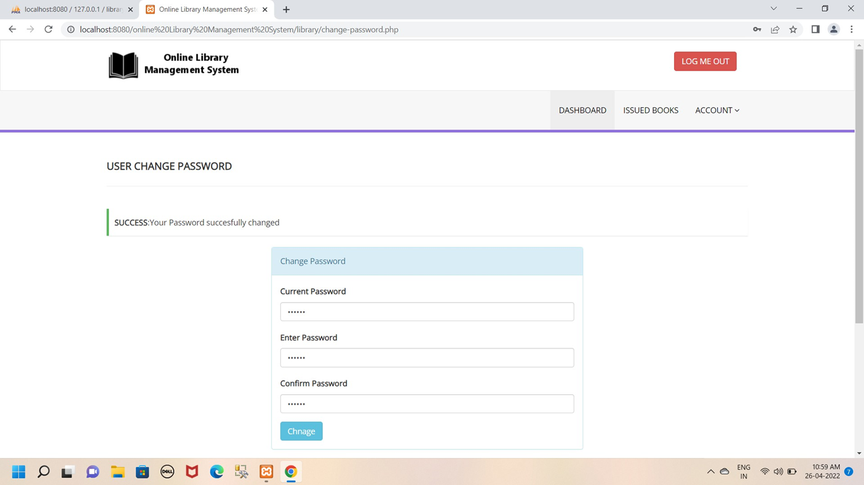
User change password:

Slide 28
Chapter 10
Future Enhancement
It is not possible to devlop a system that makes all the requirement of the user. User requirements keep changing as the system is being used. Some of the future enhancement thet can be done to this system are:
As the technology emerges,it is possible to upgrade the system and can be adaptable to discire environment.
Based on the future security issue,security can emerging technologies.
Sub admin module can be added.
be improve using

Slide 29
Chapter 11
Conclusion
This “Library Management System” has been computed sucefully and was also tested successfully by tacking “test cases” . it is user friendly,and has required option, which can be ultilzed by the user ton perform the desired operation.
The software is developed using php as front end and mysql as back end windows environment.the goles that are achieved by the software are:
Optimum utilzetion of sources.
Efficient management of records.
Simplification of the operations.
Less processing time and getting required information.
User friendly.
Portable and flexible for further enhancement.

Slide 30
Chapter 12
Bibliography
Website
www.books.com
www.Google.com
www.librarywala.com

